Slide 1
Containers and Layout Managers in Java
Lecture 17
Understanding GUI Organization

Slide 2
What are Containers?
Containers are special components in Java Swing that hold and organize GUI components (e.g., buttons, text fields).
Examples of Containers:
JFrame: Main container for a GUI application.
JPanel: A smaller container for organizing components within a JFrame.
JDialog: A pop-up dialog window.
JApplet: For applets (now obsolete).

Slide 3
Types of Containers
1- Top-Level Containers:
JFrame: Represents the main application window.
JDialog: Used for pop-up dialogs.
JWindow: Borderless, undecorated windows.
2- Intermediate Containers:
JPanel: A flexible container for grouping components.
3- Lightweight Containers:
Built within the Swing framework (e.g., JPanel, JLayeredPane).

Slide 4
Layout Managers
What is a Layout Manager?
A Layout Manager defines how components are arranged in a container.
Helps manage the size and position of components dynamically.
Why Use Layout Managers?
Automatic resizing and alignment.
Consistent UI across different screen sizes and resolutions.

Slide 5
Types of Layout Managers
FlowLayout
Default for JPanel.
Aligns components left-to-right in a row.
Example: Toolbar with buttons.
BorderLayout
Divides the container into 5 regions: North, South, East, West, and Center.
Example: Web browser layout (menu, content area, status bar).
GridLayout
Divides the container into equal-sized rows and columns.
Example: Calculator buttons.

Slide 6
Types of Layout Managers
GridBagLayout
More flexible version of GridLayout.
Allows different sizes for components.
BoxLayout
Aligns components in a horizontal or vertical line.
CardLayout
Stacks components like cards (only one visible at a time).
Example: Tabbed panels.

Slide 7
Example: FlowLayout
import javax.swing.*;
import java.awt.*;
public class FlowLayoutExample {
public static void main(String[] args) {
JFrame frame = new JFrame("FlowLayout Example");
frame.setLayout(new FlowLayout());
frame.add(new JButton("Button 1"));
frame.add(new JButton("Button 2"));
frame.add(new JButton("Button 3"));
frame.setSize(300, 100);
frame.setDefaultCloseOperation(JFrame.EXIT_ON_CLOSE);
frame.setVisible(true);
} }

Slide 8
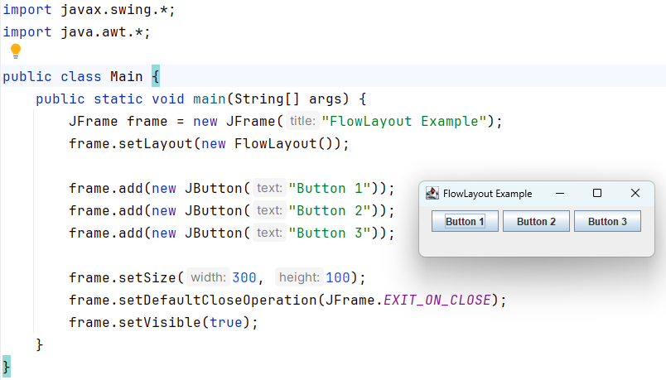
Example: FlowLayout

Slide 9
Example: BorderLayout
import javax.swing.*;
import java.awt.*;
public class BorderLayoutExample {
public static void main(String[] args) {
JFrame frame = new JFrame("BorderLayout Example");
frame.setLayout(new BorderLayout());
frame.add(new JButton("North"), BorderLayout.NORTH);
frame.add(new JButton("South"), BorderLayout.SOUTH);
frame.add(new JButton("East"), BorderLayout.EAST);
frame.add(new JButton("West"), BorderLayout.WEST);
frame.add(new JButton("Center"), BorderLayout.CENTER);
frame.setSize(400, 200);
frame.setDefaultCloseOperation(JFrame.EXIT_ON_CLOSE);
frame.setVisible(true);
} }

Slide 10
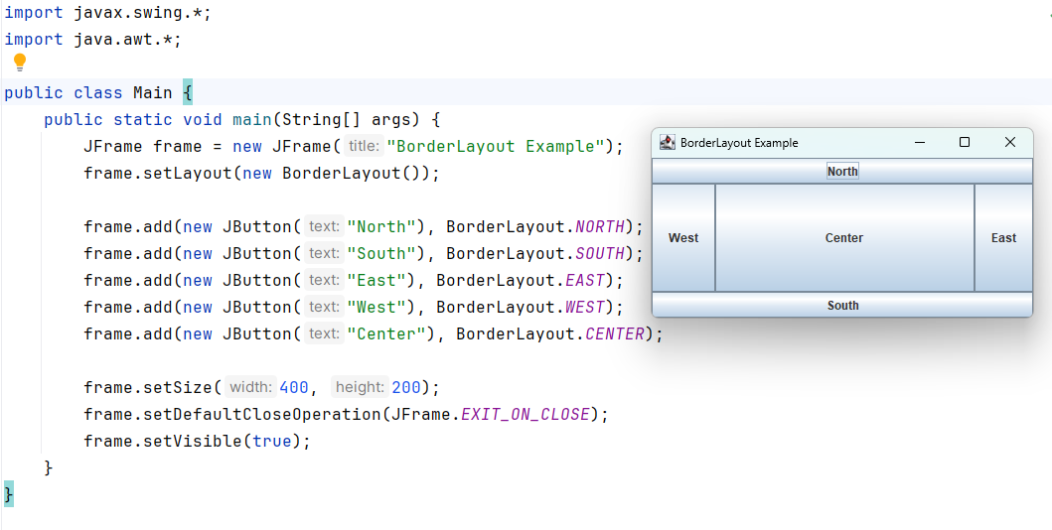
Example: BorderLayout

Slide 11
Example: GridLayout
import javax.swing.*;
import java.awt.*;
public class GridLayoutExample {
public static void main(String[] args) {
JFrame frame = new JFrame("GridLayout Example");
frame.setLayout(new GridLayout(2, 3)); // 2 rows, 3 columns
for (int i = 1; i <= 6; i++) {
frame.add(new JButton("Button " + i));
}
frame.setSize(300, 200);
frame.setDefaultCloseOperation(JFrame.EXIT_ON_CLOSE);
frame.setVisible(true);
} }

Slide 12
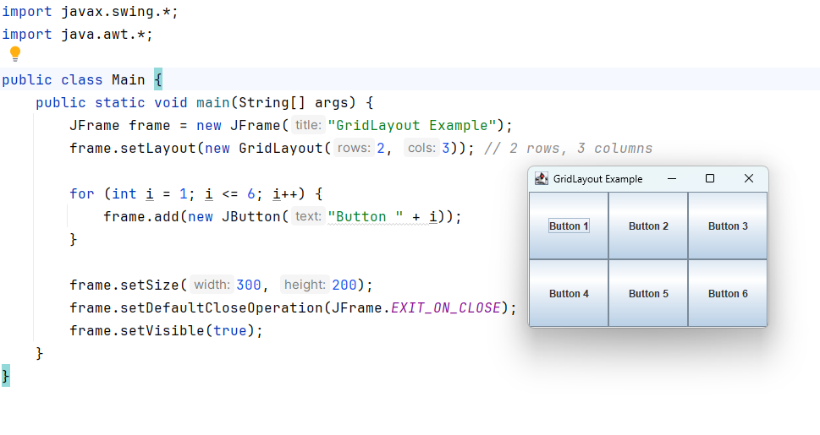
Example: GridLayout

Slide 13
Example: CardLayout
import javax.swing.*;
import java.awt.*;
public class CardLayoutExample {
public static void main(String[] args) {
JFrame frame = new JFrame("CardLayout Example");
CardLayout cardLayout = new CardLayout();
JPanel panel = new JPanel(cardLayout);
panel.add(new JButton("Card 1"), "Card1");
panel.add(new JButton("Card 2"), "Card2");
frame.add(panel);
cardLayout.show(panel, "Card1");
frame.setSize(300, 200);
frame.setDefaultCloseOperation(JFrame.EXIT_ON_CLOSE);
frame.setVisible(true);
} }

Slide 14
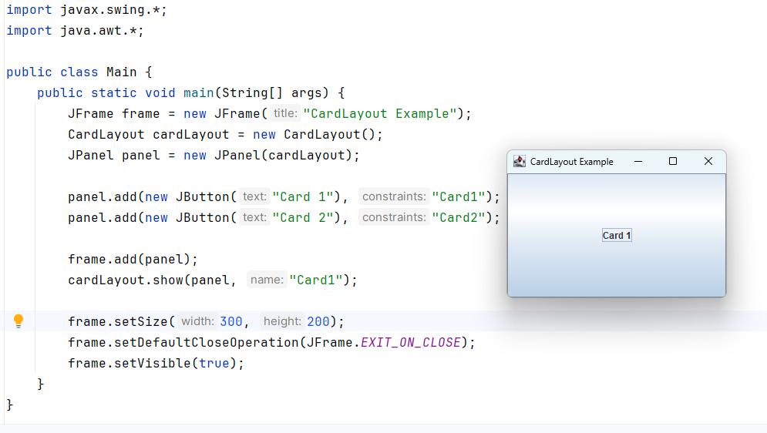
Example: CardLayout

Slide 15
Restaurant Order Management System
You are tasked with developing a simple restaurant order management GUI. The system should allow users to:
Select food items from a menu (e.g., Burger, Pizza, Pasta).
Input the quantity for each item.
Calculate the total cost of the selected items.
The layout of the GUI should use different containers and layout managers to create a user-friendly interface:
BorderLayout for the main structure.
FlowLayout for item selection.
GridLayout for quantity input and total cost.

Slide 16
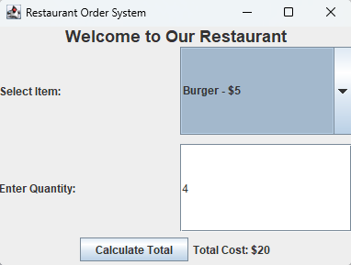
Requirements:
A main window (JFrame) with a title "Restaurant Order System".
North Panel (BorderLayout): A JLabel with the title of the system.
Center Panel (GridLayout):
Combobox to select items.
TextField to input quantity.
South Panel (FlowLayout):
JButton to calculate the total cost.
JLabel to display the calculated cost.

Slide 17
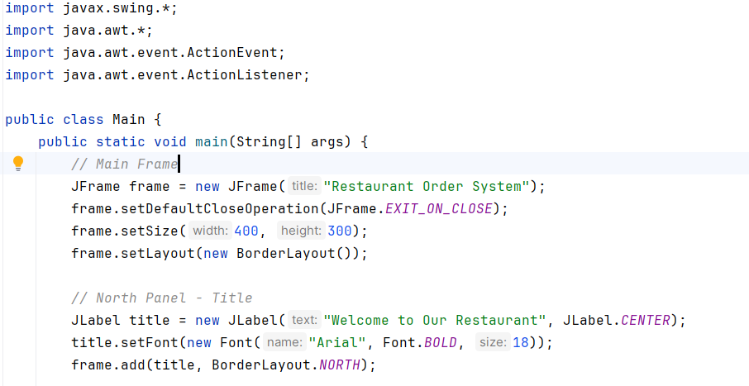
Solution:

Slide 18
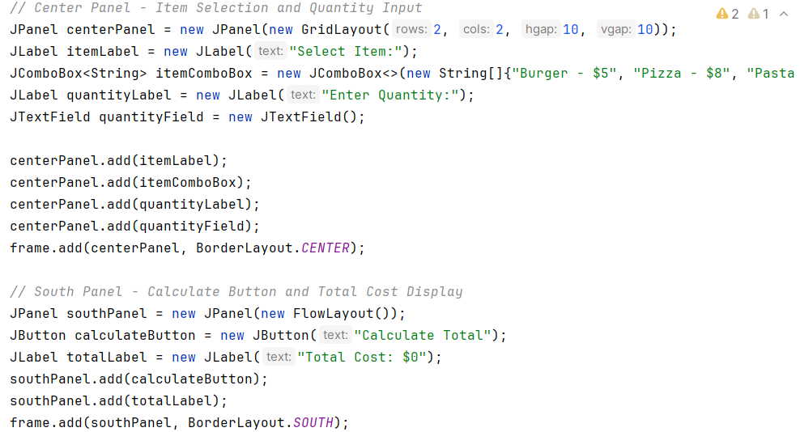
Solution:

Slide 19
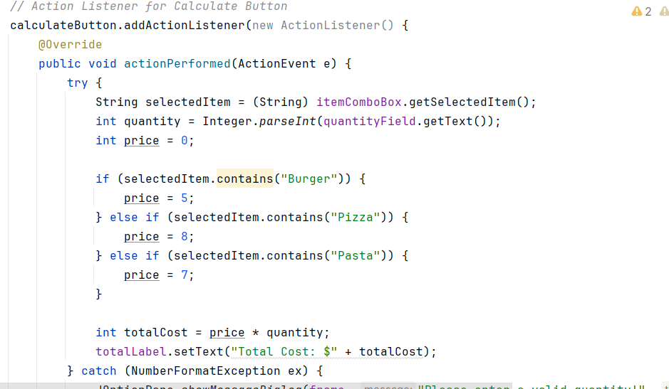
Solution:

Slide 20
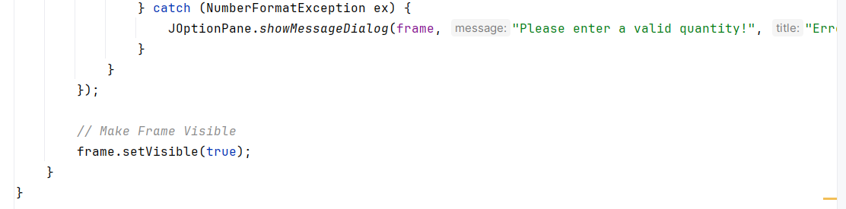
Solution:

Slide 21
Solution:
import javax.swing.*;
import java.awt.*;
import java.awt.event.ActionEvent;
import java.awt.event.ActionListener;
public class Main {
public static void main(String[] args) {
// Main Frame
JFrame frame = new JFrame("Restaurant Order System");
frame.setDefaultCloseOperation(JFrame.EXIT_ON_CLOSE);
frame.setSize(400, 300);
frame.setLayout(new BorderLayout());
// North Panel - Title
JLabel title = new JLabel("Welcome to Our Restaurant", JLabel.CENTER);
title.setFont(new Font("Arial", Font.BOLD, 18));
frame.add(title, BorderLayout.NORTH);
// Center Panel - Item Selection and Quantity Input
JPanel centerPanel = new JPanel(new GridLayout(2, 2, 10, 10));
JLabel itemLabel = new JLabel("Select Item:");
JComboBox<String> itemComboBox = new JComboBox<>(new String[]{"Burger - $5", "Pizza - $8", "Pasta - $7"});
JLabel quantityLabel = new JLabel("Enter Quantity:");
JTextField quantityField = new JTextField();
centerPanel.add(itemLabel);
centerPanel.add(itemComboBox);
centerPanel.add(quantityLabel);
centerPanel.add(quantityField);
frame.add(centerPanel, BorderLayout.CENTER);
// South Panel - Calculate Button and Total Cost Display
JPanel southPanel = new JPanel(new FlowLayout());
JButton calculateButton = new JButton("Calculate Total");
JLabel totalLabel = new JLabel("Total Cost: $0");
southPanel.add(calculateButton);
southPanel.add(totalLabel);
frame.add(southPanel, BorderLayout.SOUTH);
// Action Listener for Calculate Button
calculateButton.addActionListener(new ActionListener() {
@Override
public void actionPerformed(ActionEvent e) {
try {
String selectedItem = (String) itemComboBox.getSelectedItem();
int quantity = Integer.parseInt(quantityField.getText());
int price = 0;
if (selectedItem.contains("Burger")) {
price = 5;
} else if (selectedItem.contains("Pizza")) {
price = 8;
} else if (selectedItem.contains("Pasta")) {
price = 7;
}
int totalCost = price * quantity;
totalLabel.setText("Total Cost: $" + totalCost);
} catch (NumberFormatException ex) {
JOptionPane.showMessageDialog(frame, "Please enter a valid quantity!", "Error", JOptionPane.ERROR_MESSAGE);
}
}
});
// Make Frame Visible
frame.setVisible(true);
}
}

